Slide 1

There Shouldn’t Be Dragons Graphing the Cup-L Project
Jonathan Butner
DEPARTMENT OF PSYCHOLOGY | THE UNIVERITY OF UTAH

Slide 2

Mapping Psychology
The phrase “Here be dragons” used by cartographers for indicating dangerous or unknown territories
  Medieval practice of adding mythical creatures to uncharted territories of maps
Math of dynamical systems is also the math of maps
  I can explain very complex systems concepts to non-systems folks
  It helps us understand our systems concepts better too

Slide 3
Data from Systems ‘N Coffee: the ONe Cup-L Project
Utah Dynamical Systems Reading Group
  Sync (Systems ‘N Coffee)
This Year Conducting all the types of dynamical systems style analyses on the data from a single couple
  Calling it the One Cup-L Project
Today I am going to present a small slice of results
  Specifically a graphical (map) perspective

Slide 4
The Couple, One Day
16 Hours of Heart Rate Data
  Measured at a 128 Hz, but aggregated to 1 minute epochs
  After cleaning out artifacts (BPM > 130) we have 973 minutes of data
Also have corresponding GPS data for the couple (20 Hz)
  Define them being together as within 250 ft of one another on a given minute
By clinical standards, this is a distressed couple
  12 on the Couple Satisfaction Index (4 item version; Funk & Rogge, 2007)

Slide 5
Getting a Sense of the Territory
2 Dimensional Scatterplot
  Dimensions upon which covariation occurs
  R=.25

Slide 6
Territory By Together vs. Separate
2 Dimensional Kernel Density Plot
  Phase Portrait
    If only two dimensions
  Notice Two Close Peaks
    But some other peakedness

Slide 7
Territory By Together vs. Apart
Together
Apart
R=.45
R=.20

Slide 8
Two Time Series Make Trails on a Map
Northness
Eastness
Time
Time
North
These Trails can be well understood in terms of the Maps Too
Observed Trail
South
West
East

Slide 9
Two Time Series Our trails

Slide 10
Vector Plots Together and Apart
Vector Plots
  State Space
Tough to See but Some Lessons
  Oscillations/Coupling Make Loopy Trails (e.g. Celtic Knots)
  Does not seem to have oscillations

Slide 11
Vectors By Together vs. Apart
Does Not appear very loopy, if oscillatory, it is not a prominent feature

Slide 12
Spline By Together vs. Apart
Again, not prominent, but possibly some angular motion

Slide 13
Analysis
Data is in Toeplitz (time delay) format
Latent Change Score Modeling uses fixed relationships between dummy latent variables to construct change
Combined with Finite Mixture Modeling to Extract Different Topo Features
BPM W_{T}
BPM W_{T+1}
ΔW
1
1
ΔH
BPM H_{T}
BPM H_{T+1}
Dashed Arrows Fixed to 1
Red Arrows Allowed to Differ Across Groups

Slide 14
Results: 3 Topo Features
1st Feature: 46% of Vectors

Slide 15
Results: 3 Topo Features
2nd Feature: 18% of Vectors

Slide 16
Results: 3 Topo Features
3rd Feature: 35% of Vectors

Slide 17
Results: 3 Topo Features
All Three Rebuild the Map

Slide 18
Results: Recall the Together/Apart Difference
Red Significantly more Likely when Apart
Blue and Black not different by Togetherness

Slide 19
There is a Ton we Can Learn From Mapping the Data
Easy way to explain our effects
Observe the proper level of analysis
Explain complex ideas to non (less) systems folks
See the distinctions between data and our models

Slide 20
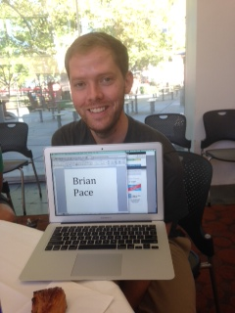

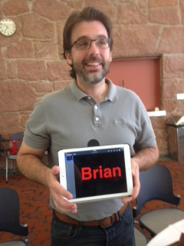
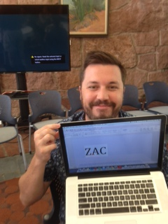


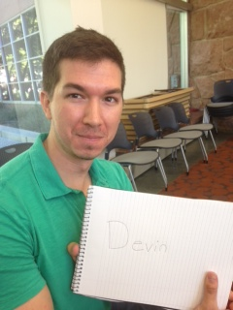
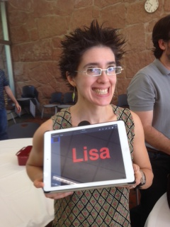
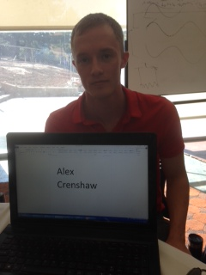
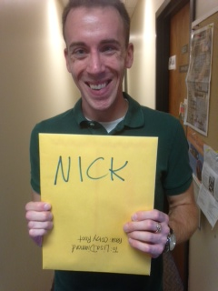


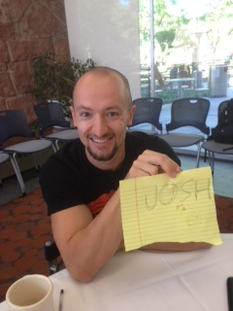
Systems ‘n Coffee (Sync)
(POST DOCs Available NOW)

