Slide 1
Depression as Dysfunction
of the Social Engagement System
Jill M. Cyranowski, PhD
Associate Professor of Psychology
Graduate Psychology Program
Chatham University

Slide 2



Positive social relationship have positive impact on emotional and physical health
❖ CVD morbidity and mortality
Supportive social relationships buffer or modulate stress reactions
❖ Reduce or suppress stress-induced cardiovascular reactivity
Nearly all research on the social modulation of stress in humans has excluded depressed individuals
Supportive Social Relationships

Slide 3


Depressed individuals among those with poorest social function
❖ Low social support
❖ Greater social distress
❖ MDD episodes often triggered or maintained by relational distress
MDD episodes are associated with physiologic dysregulation across stress-related systems
❖ Cardiovasular, HPA, and immune/inflammatory reactivity to stress; ANS (vagal) function
MDD and the Social Modulation of Stress

Slide 4


Women are about twice as likely as men to experience a lifetime episode of depression
❖ Greater sensitivity to depresso-genic effects of interpersonal life stress
❖ High anxiety comorbidity
Maternal Transmission of MDD Risk
❖ Offspring of depressed mothers have 2- to 5-fold increased risk of psychiatric illness (and poorer treatment outcomes)
❖ How is this risk transmitted?
Women, MDD and the Social Modulation of Stress

Slide 5
Early (proxy) findings regarding dysregulation of adaptive social modulation of stress in depression
  Impact of thinking of a close/love relationship among depressed and non-depressed women
  Impact of talking about a child-focused conflict among depressed moms
Moms pilot research – Linking maternal-child social interaction data
❖ Basic Study Platform
❖ Multiple mechanisms and data streams
Potential clinical implications
❖ Can data inform treatments?
Overview

Slide 6
Do depressed and non-depressed women show differences in the social modulation of stress?

Slide 7
Proxy Study 1: Biobehavioral Mechanisms
◆ 19 depressed, 19 controls females age 20-40
❖ Medically healthy, not on AD medications
Two experimental tasks (baseline, task, recovery)
❖ Speech stress task
❖ Relationship focused task
Blood draws q5 minutes
1 2 3 4 5 6 7 8 9 10 11 12
1 2 3 4 5 6 7 8 9 10 11 12
30 minute
Resting
Recovery
30 minute
Resting
Recovery
20 minute
Resting
Baseline
20 minute
Resting
Baseline
25 m
Habituation
10 min
TASK
# 1
10 min
TASK
# 2

Slide 8
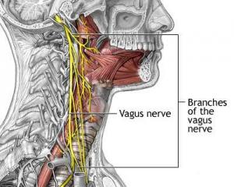
Depression and Vagal Dysfunction
Polyvagal Theory (Porges, 2007) vagal pathways evolved in mammals to allow for social engagement & affiliation via flexible modulation of sympathetic fight-or-flight responses, and facilitation of emotional expression & social communication
Vagal innervation of the myocardicum provides parasympatethic control of heart rate (‘vagal brake’)
Collateral branches also terminate on soft palate, pharynx, larynx, facial muscles - emotional expression and social communication
Notes:
❖ Parasympathetic control of HR (vagal brake)

Slide 9
MDD, Social Dysfunction and the Vagus
Depression associated with impaired (diminished) cardiac vagal function – Rottenberg, 2007
❖ Relationship may differ by gender
❖ Diminished RSA also associated with:
Anxiety, acute stress, social isolation
Diminished vagal function associated with:
(1) Emotional dysregulation - depression & anxiety
(2) Social dysfunction – unmarried, social isolation
(3) Stress-related CV regulation - CVD risk

Slide 10
Measuring Vagal Function
Indirect indicators of cardiac vagal control – measured via continuous EKG, spectral analyses
❖ Vagal effects on HR occur rapidly (in milliseconds)
❖ Changes in HR that occur in high frequency range of HR variability (0.15-0.50 Hz) used to index vagal tone (commonly referred to as high-frequency HRV)
❖ Vagal withdrawal: rapid shift to sympathetic dominance during time of threat/stress
❖ Vagal activation: slows HR to favor energy conservation / parasympathetic dominance during times of rest or perceived safety (social affiliation)

Slide 11
Results: Impact of Lab Tasks on RSA
Speech Stress
Task
F(3,66) = 4.36,
p=.02
Relationship
Imagery Task
F(3,66) = 3.79,
p=.02
Cyranowski et al.,
Psychosomatic
Med, 2011

Slide 12
Relationship Imagery Results
Non-adjusted RSA: Period [F(3,66)=3.79, p=.02]; Group [F(1,22)=5.54, p=.028]
Cyranowski et al., 2011

Slide 13
Relationship Imagery Results
Non-adjusted RSA: Period [F(3,66)=3.79, p=.02]; Group [F(1,22)=5.54, p=.028]
Cyranowski et al., 2011

Slide 14
Stress Task Results: MDD x Trauma History
Models with non-adjusted RSA. Period [F(3,66)=4.36,p=.02], Group x Trauma History [F(1,22)=9.61, p=.05]
Cyranowski et al., 2011

Slide 15
Proxy Study #2: Evaluating child-focused stress
reactivity among depressed and non-depressed moms
Recruited 22 depressed mothers from RCT (TAU or IPT) and 22 matched non-depressed controls
Laboratory Design
❖ 5 minute child-focused free-speech task (tell me about your child…)
❖ 10 minute child focused stress task (discuss recent situation with your child that made you angry / stressed)
5
minute
Free
speech
task
10 minute
Speech
Stress
Task
10 minute
Resting
Baseline
10 m
Habituation

Slide 16
DEPRESSED MOMS - Emotional and CV Reactivity
to a Child-Focused Interpersonal Stress
POMS Depression Reactivity
N = 44
Cyranowski et al, Depression & Anxiety, 2009

Slide 17
DEPRESSED MOMS - Emotional and CV Reactivity
to a Child-Focused Interpersonal Stress Task
Heart Rate Reactivity Systolic BP Reactivity
Other predictors: maternal childhood history of emotional abuse,
chronic parental stress
Cyranowski et al, Depression & Anxiety, 2009

Slide 18
Current Pilot Work
Can we study these physiological indictors of depression-related social dysfunction
in mother-child dyads
as they are interacting?

Slide 19


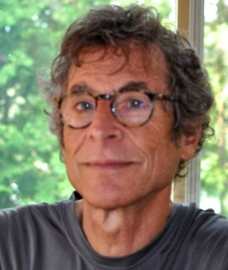


The MOMS pilot research team
Parent study and supplement
Holly Swartz, MD
Vagal Data
Marlissa Amole
Facial Coding data
Jeff Cohen, PhD
Jeff Girard
fMRI Imaging data
Erika Forbes, PhD

Slide 20
PILOT: Evaluating mother-child interactions
Among depressed and non-depressed dyads
Originally recruited mother-child dyads from tx study
❖ Lab: 23 dep, 23 control mother-daughter dyads
Laboratory interactions
❖ Positive event discussion (6 min)
3 min discussion of past positive event
3 min discussion planning for future positive event
❖ Conflict task (6 min)
6
minute
Resting
Baseline
6 minute
2 Positive
Interaction
Tasks
6 minute
Resting
Recovery
6 minute
Conflict
Interaction
Task
6 minute
Resting
Recovery
2
min
Positive
interaction
prep
2
min
Negative
interaction
prep
6 min
Habituation

Slide 21
High-Frequency HRV Data
Will depressed mother-child dyads show
diminished vagal responsiveness to
social interactions?

Slide 22
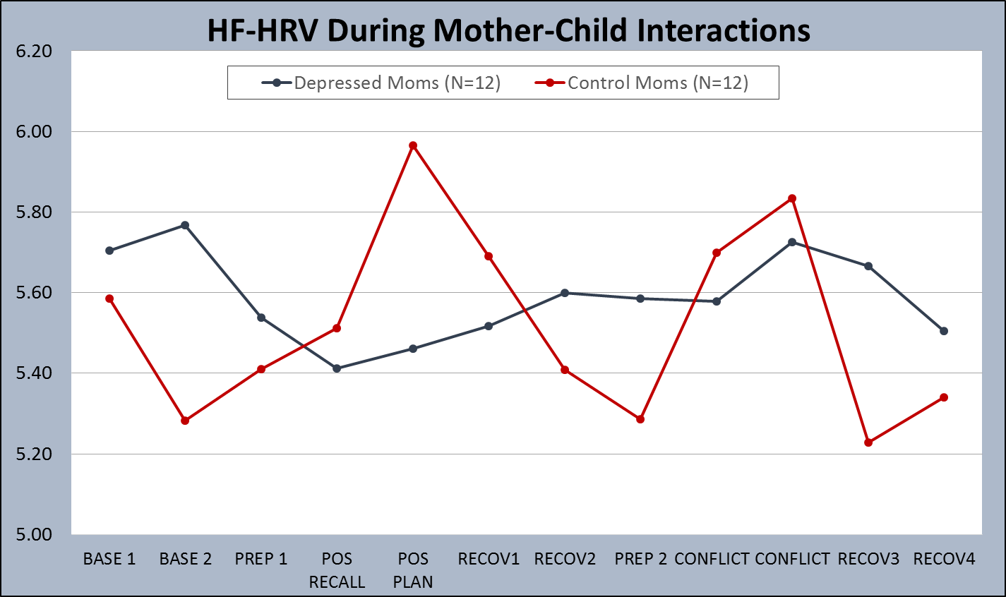
Initial Results: HF-HRV in Mothers

Slide 23
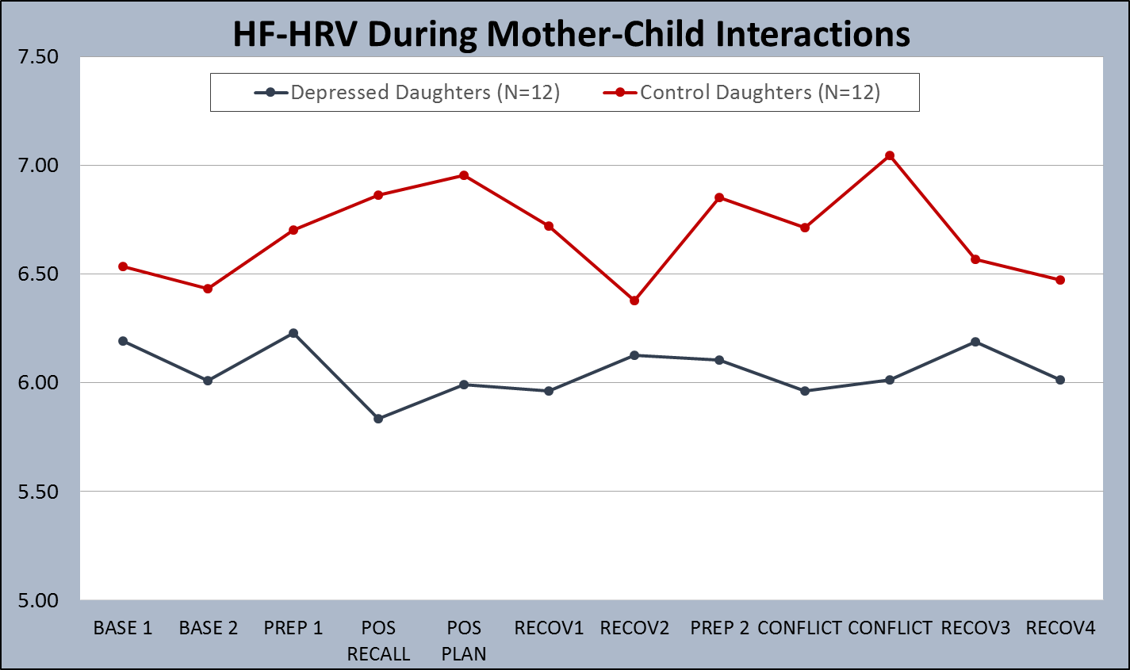
Initial Results: HF-HRV in Daughters

Slide 24
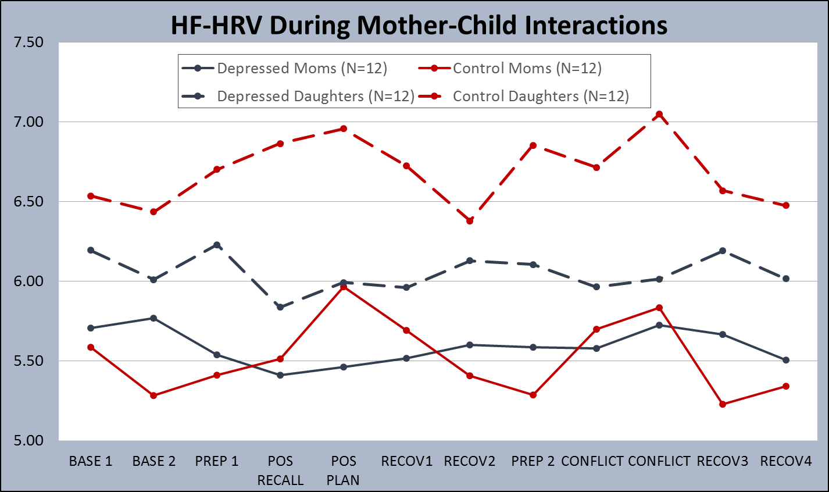
Initial Results: HF-HRV across Dyads

Slide 25
❖ How can we model this pattern of covariation?
❖ How small to ‘chunk’ the HF-HRV data?
❖ Modeling bi-directional relationships

Slide 26
❖ THESE are the at-risk dyads we’re most interested in
❖ Can we model covariation without much variation?
❖ Can we link HF-HRV to facial/behavioral data??

Slide 27
Automated Facial Expression Analysis
Can we measure facial expressions during interactions?
Can we link these to vagal function?

Slide 28
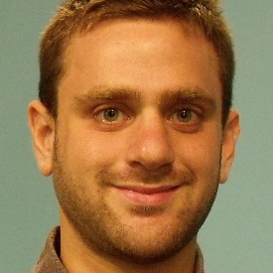
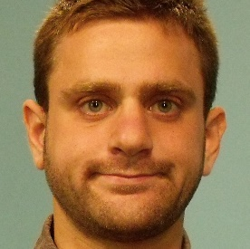
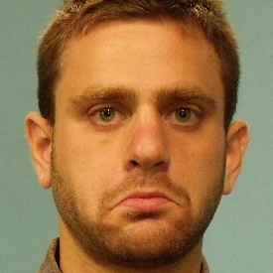
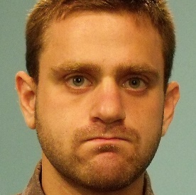
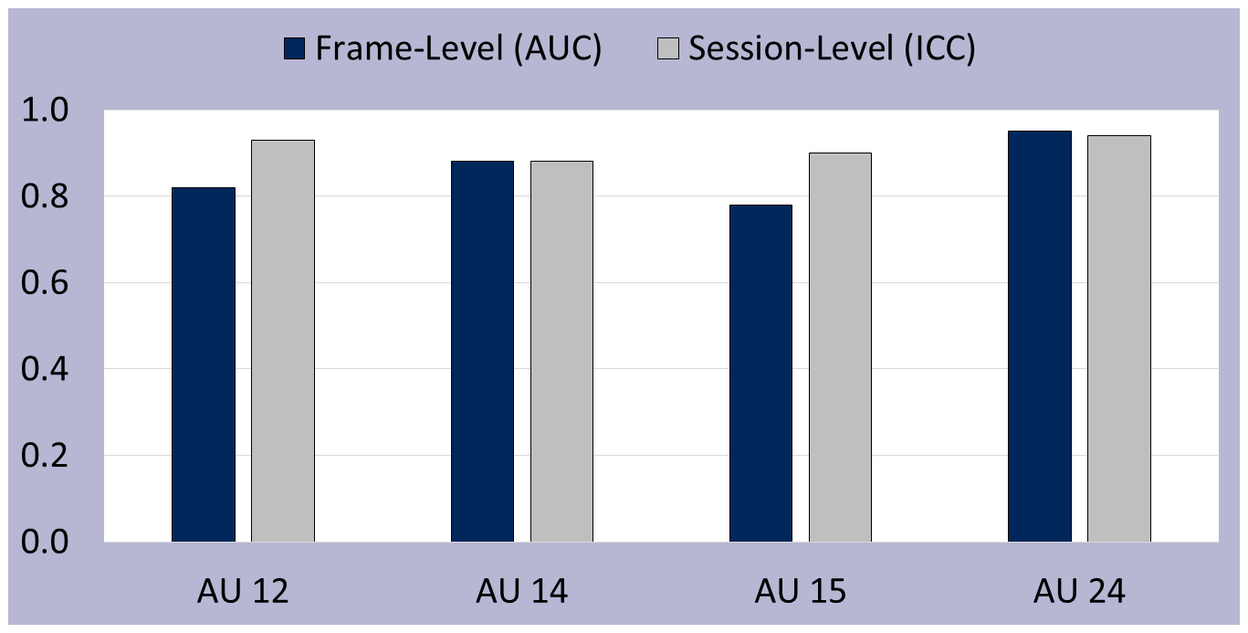
Comparison of Manual and Automated FACS
Girard, J. M., Cohn, J. F., Mahoor, M. H., Mavadati, S. M., Hammal, Z., & Rosenwald, D. P. (2014). Nonverbal social withdrawal in depression: Evidence from manual and automatic analyses. Image and Vision Computing, 32(10), 641–647.

Slide 29
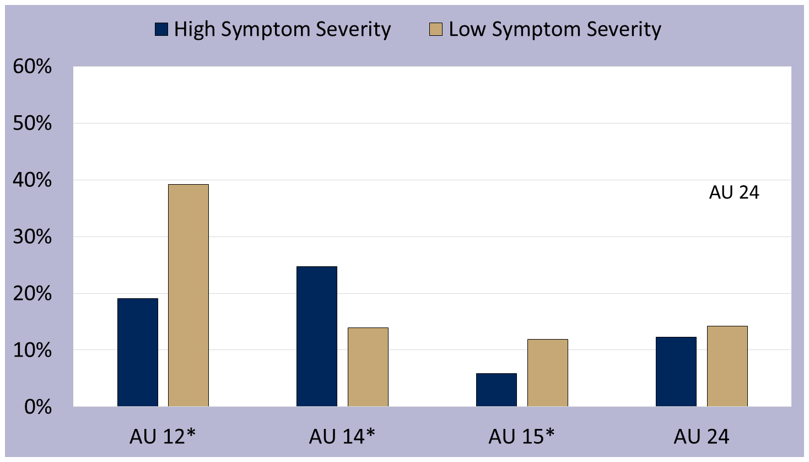
Facial Action Coding System (FACS) in Depression
p < .05
AU 12
AU 14
AU 15
p < .05
p < .05
Girard, J. M., Cohn, J. F., Mahoor, M. H., Mavadati, S. M., Hammal, Z., & Rosenwald, D. P. (2014). Nonverbal social withdrawal in depression: Evidence from manual and automatic analyses. Image and Vision Computing, 32(10), 641–647.

Slide 30
Automated FACS Mother-Daughter Interactions
Could facial expressiveness represent one mechanism linking HF-HRV covariation?
❖ Can we link FACS data to HF-HRV?
❖ Can we model reciprocal interactions in facial expressiveness? Link these to behavioral measures?

Slide 31
Clinical Implications
How do we “re-engage” the vagally-mediated social engagement system for depressed patients?
❖ Can we identify key process mechanisms of IPT (Interpersonal Psychotherapy) for depression?
❖ Can we develop improved measures of social function; make these central outcome in MDD tx?
❖ Are there dyadic physiological processes going on in the therapy relationship that we can capture?
Curbing intergenerational transmission of MDD
❖ Should we incorporate dyadic interventions to scaffold positive covariation (ie, expression, attention, responsivity to POSITIVE affect) or enhance vagal responsiveness?

Slide 32
Acknowledgements
Depression and Manic-Depression Prevention Program
Holly Swartz, MD Marlissa Amole, BA
Stacy Martin, MA Susan Murphy, BS
Facial Coding Colleagues
Jeff Cohn, PhD Jeff Girard, MA
Imaging Colleagues
Erika Forbes, PhD Marigrace Ambrosia
Jen Silk, PhD Sam Musselman
Judith Morgan, PhD
Statistical Colleagues
Aidan Wright, PhD
Grant support. Administrative supplement to R01 MH83647; Additional NIMH (MH64144, MH61948, MH085874), and the Pittsburgh Mind-Body Center (HL076852)

