Slide 1

Emotion dynamics
A network approach to emotion dynamics in dyads
Peter Kuppens and Eva Ceulemans
KU Leuven - University of Leuven, Belgium
Research Group Quantitative Psychology and Individual Differences
University of Leuven, Belgium

Slide 2

Overview
Peter:
  Emotion
  Emotion dynamics
  Emotion networks
Eva:
  How to obtain intraindividual network?
  Building a dyadic network
  Challenges

Slide 3


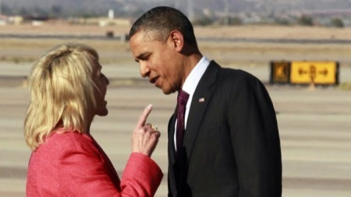

Emotions
Emotions play a large role in our lives
joy anger sadness ?
... colour our lives
important determinants of many aspects of our lives:
Influence our behavior, perception, memory, likes and dislikes, well-being, etc...

Slide 4

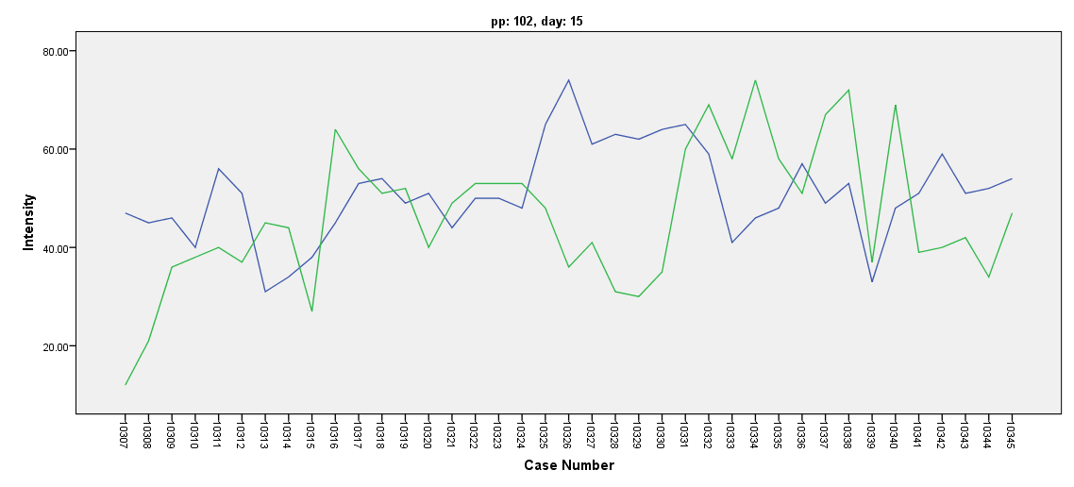
Emotion dynamics
1 important thing I want to say about emotions
→ Emotions are DYNAMIC phenomena
One of most fundamental properties of our emotions is that they continuously change across time

Slide 5
Emotion dynamics
1 important thing I want to say about emotions
→ Emotions are DYNAMIC phenomena
In fact: very reason why we have emotions in the first place lies in their dynamic nature
Emotional and affective changes:
  alert us of important events that are relevant to our well-being
  motivate us to respond appropriately
→ emotions only have meaning BECAUSE they change across time (if not, useless or very disruptive)
→ time dynamic nature lies at very heart of emotions

Slide 6
EMOTION

Slide 7
EMOTION

Slide 8
ME
TI
⇒ Time is fundamental aspect of emotions
Understanding the nature of emotions implies studying their time dynamic nature

Slide 9
Emotion dynamics
How can we understand the dynamic interplay between emotional states (or emotion components) across time?
→ One approach: network approach to emotion dynamics
sad
happy
time

Slide 10

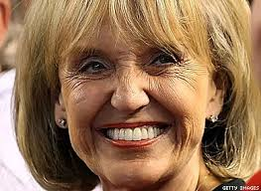

Emotion networks
Network approach to emotion dynamics:
Emotion system as network
Different emotional states (components) form nodes in network
Dynamic interrelations between emotions (components) captured as connections (edges) between nodes across time

Slide 11
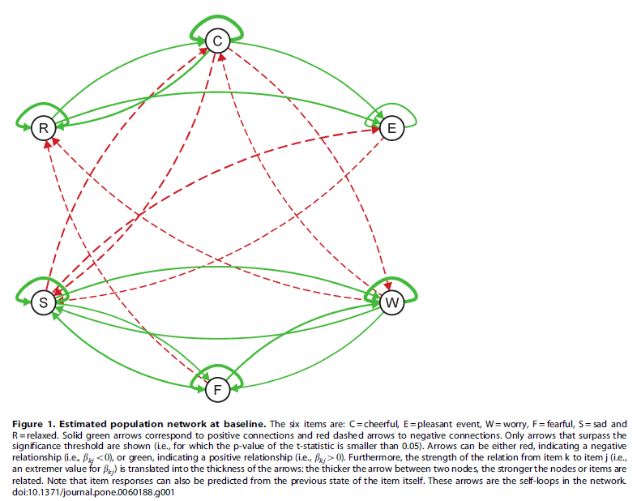
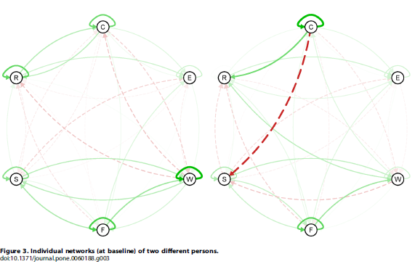
Emotion networks
Network approach to emotion dynamics:
Bringmann et al., 2013, PlosONE

Slide 12
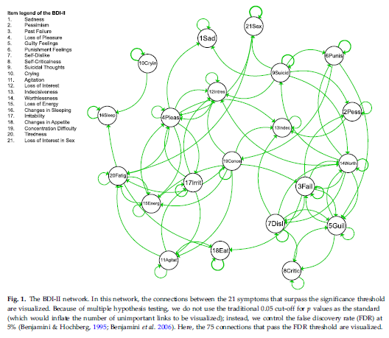
Emotion networks
Network approach to emotion dynamics:
Bringmann et al., 2014, PsychMedicine

Slide 13
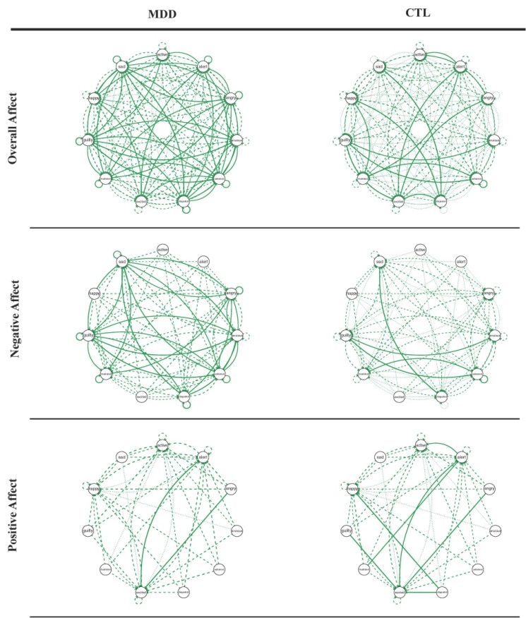
Emotion networks
Network approach to emotion dynamics:
Pe et al., 2014, ClinPsychScience

Slide 14
Emotion networks
Network approach to INTERPERSONAL emotion dynamics:

Slide 15
Emotion networks
Network approach to INTERPERSONAL emotion dynamics:

Slide 16
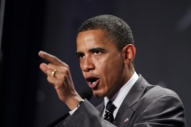




Emotion networks
Network approach to INTERPERSONAL emotion dynamics:

Slide 17
Mathematics of emotion networks
How to obtain intraindividual network?
  Fit vector-autoregressive (VAR) model
  Visualize regression slopes in network figure
  Compute network characteristics
Building a dyadic network
Challenges
  Network characteristics that capture dyadic interplay
    Issue: which edges should one use?
  Clustering dyads
  What if number of variables grows large

Slide 18
Intraindividual network
1. Fit VAR-model
Predict each emotion at time point t on the basis of all emotions at time point t-1
intercepts
slopes:
auto-regressive effects
cross-lagged effects
innovations:
part that cannot
be predicted
based on t-1

Slide 19
Intraindividual network:
1. Fit VAR-model
Predict each emotion at time point t on the basis of all emotions at time point t-1
intercepts
slopes:
auto-regressive effects
cross-lagged effects
innovations:
part that cannot
be predicted
based on t-1
edges of network

Slide 20









Intraindividual network:
2. Network figure
Draw network, for instance, using R package Qgraph.
$$β_{joy}^{joy}$$
$$β_{anger}^{anger}$$
$$β_{joy}^{anger}$$
$$β_{anger}^{joy}$$
$$β_{sadness}^{anger}$$
$$β_{sadness}^{joy}$$
$$β_{joy}^{sadness}$$
$$β_{anger}^{sadness}$$
$$β_{sadness}^{sadness}$$

Slide 21









Intraindividual network:
3. Compute network characteristics
Several measures available: betweenness, closeness, indegree, outdegree, density, ….
All based on edges
$$β_{joy}^{joy}$$
$$β_{anger}^{anger}$$
$$β_{joy}^{anger}$$
$$β_{anger}^{joy}$$
$$β_{sadness}^{anger}$$
$$β_{sadness}^{joy}$$
$$β_{joy}^{sadness}$$
$$β_{anger}^{sadness}$$
$$β_{sadness}^{sadness}$$

Slide 22
Building a dyadic network

Slide 23
Building a dyadic network
Predict each emotion of each partner at time point t on the basis of all emotions of all partners at time point t-1

Slide 24
Building a dyadic network
Predict each emotion of each partner at time point t on the basis of all emotions of all partners at time point t-1
how do partners influence themselves

Slide 25
Building a dyadic network
Predict each emotion of each partner at time point t on the basis of all emotions of all partners at time point t-1
how do partners influence each other!!

Slide 26
Challenges:
1. Network characteristics
Derive network characteristics that focus on dyadic interplay
Issue: which edges should one use?
  Well-known from standard regression analysis: slopes also reflect variances of variables
  Slopes only reflect unique direct effects, what about shared variance
Solutions:
  Use standardized slopes
  Use relative importance measures
Y_{t}

Slide 27
Challenges:
2. Clustering dyads
If studies contain many dyads
  separate networks per dyad too complex
  overall network is parsimonious, but does not give insight into how dyads differ
Solution:
  cluster dyads based on their network
  see poster of Laura Sels and Kirsten Bulteel

Slide 28
Challenges:
3. What if number of variables grows large?
Dyad → Number of variables times two!
Solution:
  Look for so-called community structure: variables that are strongly interrelated and have similar links to the other nodes
  Replace these variables by a single node

Slide 29
EMOTION

Slide 30
EMOTION

Slide 31
E
D
N
thank you thanks to:
peter.kuppens@kuleuven.be Laura Bringmann
eva.ceulemans@kuleuven.be Kirsten Bulteel
Denny Borsboom
Ian Gotlib
Madeline Pe
Laura Sels
Francis Tuerlinckx

